Slide 1
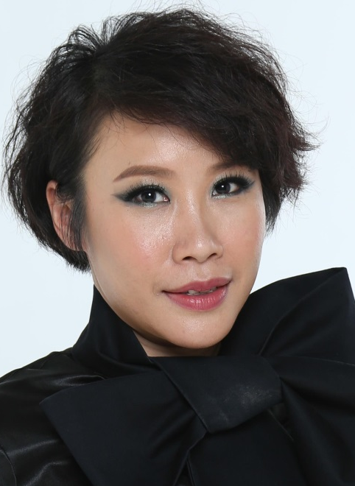

Motives 全新產品與彩妝示範
Motives - new products launch and makeover show
Angie Chou
專業經理級
Professional Coordinator
四個佣金週期共賺取HK$34,500
HK$34,500 in 4 Commission weeks
本簡報中提到的收入等級純屬舉例說明，無意代表美安香港超連鎖™店主的一般收入，也無意表示任何超連鎖™店主皆可賺取同等收入。美安香港超連鎖™店主的成功與否，取決於其在發展事業時的努力、才能與投入程度。
The income levels mentioned in the following presentation are for illustration purposes only. They are not intended to represent the income of a typical Market Hong Kong UnFranchise ™Owner, nor are they intended to represent that any given Independent UnFranchise ™ Owner will earn income in that amount. The success of any Market Hong Kong Independent UnFranchise ™ Owner will depend upon the amount of hard work, talent, and dedication which he or she devotes to building his or her Market Hong Kong Business.

Slide 2
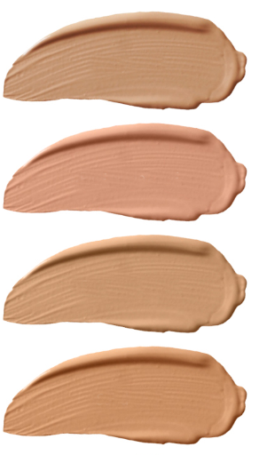
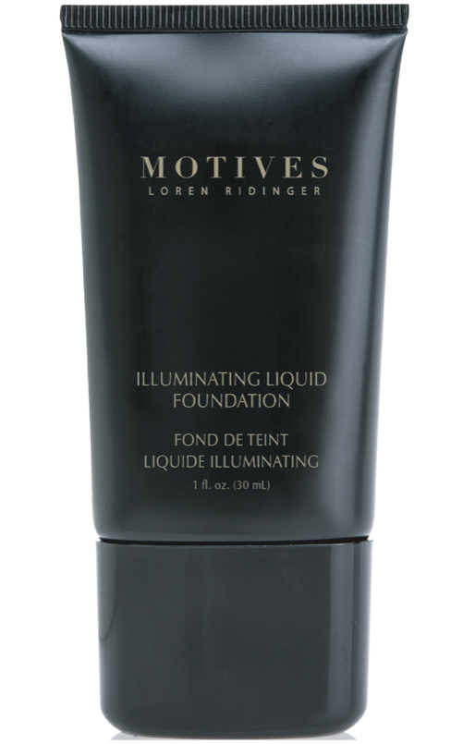
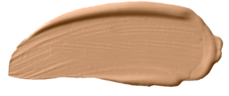
Ivory
HK40LF
COMING
SOON
Pink Nude
HK41LF
Soft Beige
HK42LF
NEW
Sand
HK43LF
Creamy Natural
HK45LF
Motives Illuminating Liquid Foundation
光采粉底液
UC: HK$203.00 | SR: HK$284.00 | BV: 18

Slide 3
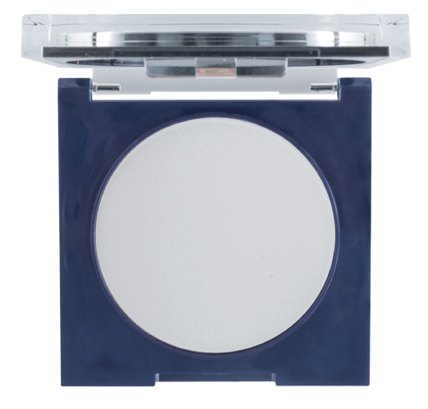
NEW
Motives Filter HD Powder
透薄定妝高清粉餅
CODE: HK360HDP
UC: HK$175.00 | SR: HK$245.00 | BV:16
Notes:
HK113MMF Motives Mineral Dual Foundation 無瑕美肌兩用粉餅 - Fair Neutral $265.00

Slide 4
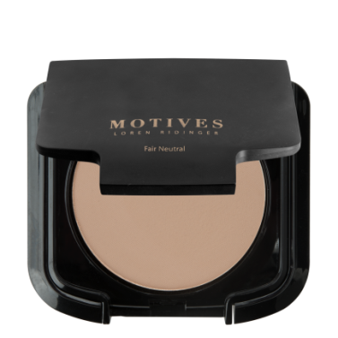
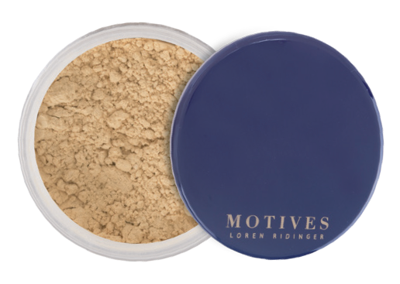
NEW
Banana
Fair Neutral
Motives Luminous Translucent Loose Powder
無瑕美肌透亮碎粉
Motives Mineral Dual Foundation
無瑕美肌兩用粉餅
CODE: HK360HDP
UC: HK$151.00 | SR: HK$211.00 BV:12
CODE: HK113MMF
UC: HK$190.00 | SR: HK$265.00
BV:15.5
Notes:
HK113MMF Motives Mineral Dual Foundation 無瑕美肌兩用粉餅 - Fair Neutral $265.00

Slide 5
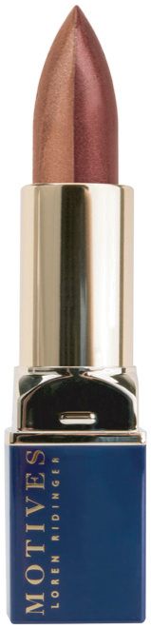
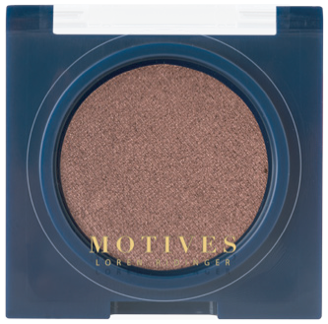

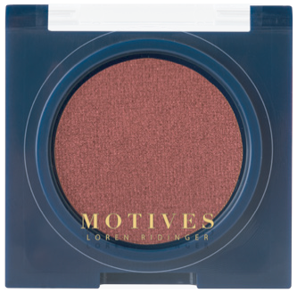
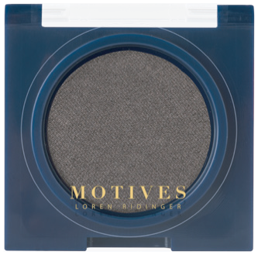

VENGEANCE
HK230MES
LIT
HK231MES
NEW
Royally Red
REBEL
HK232MES
STUDDED
HK233MES
HEADSTRONG
HK234MES
Motives Double Take Lipstick Duo潤澤雙色唇膏
Motives Pressed Eyeshadow
眼影
CODE: HK30DTD
UC: HK$129.00
SR: HK$181.00 | BV:12
UC: HK$95.00 | SR: HK$133.00
BV: 7.75

Slide 6
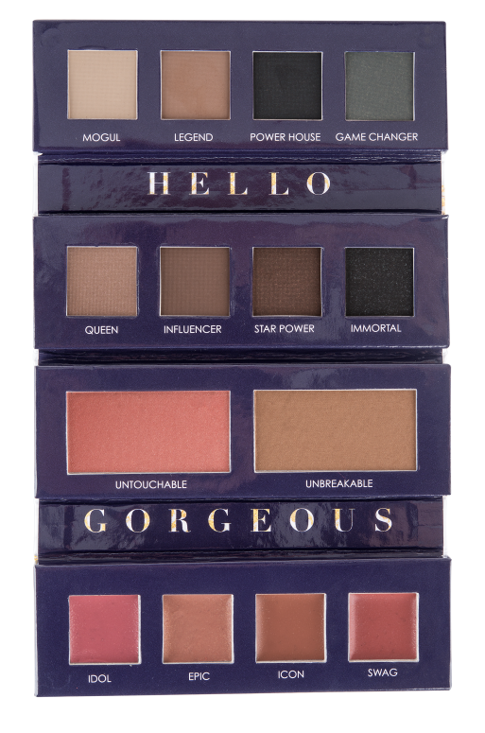

COMING
SOON
NEW
Motives Iconic Palette
彩妝組合
CODE: HKPRESH17
UC: HK$284.00 | SR: HK$398.00 | BV: 25
Notes:
Motives Illuminating Liquid Foundation光采粉底液 $284.00
HK40LF Ivory
HK41LF Pink Nude
HK42LF Soft Beige
HK43LF Sand
HK45LF Creamy Natural

Slide 7
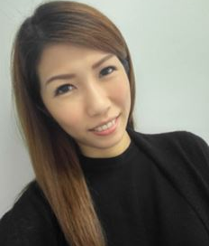
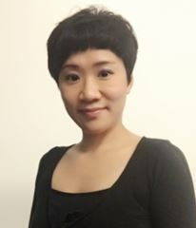
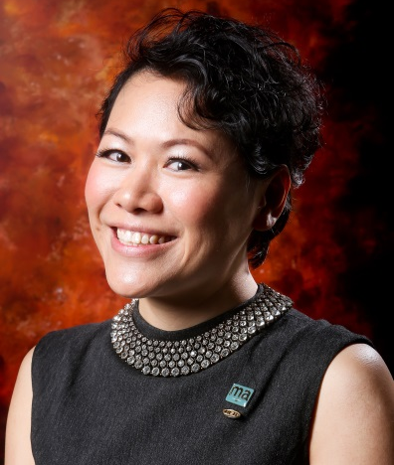
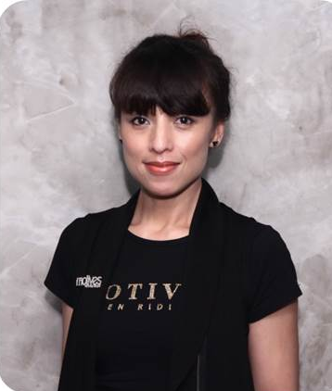
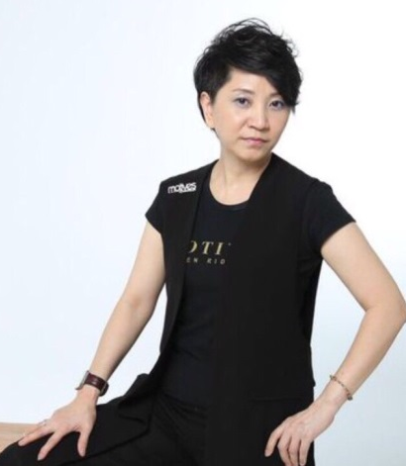
MOTIVES®授證訓練員
Meko Lun
Mandy Ng
Thorine Mak
Rose Wong
Pat Chan

Slide 8
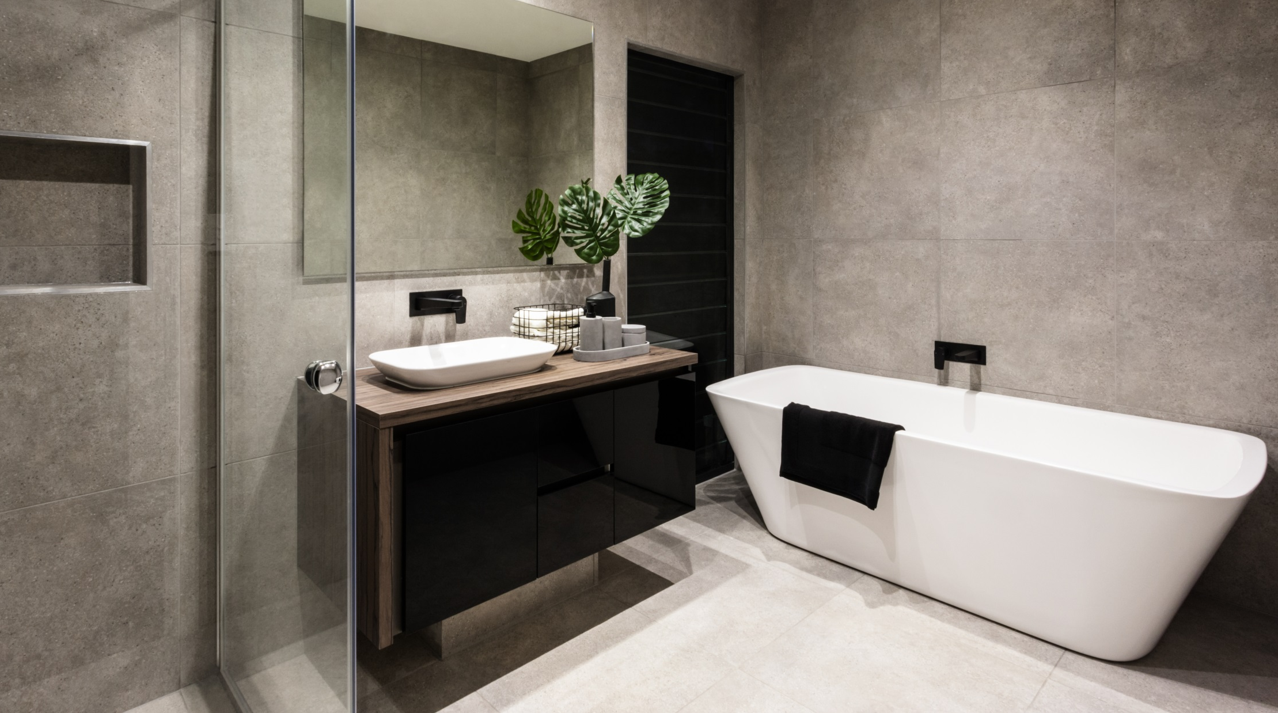

Slide 9
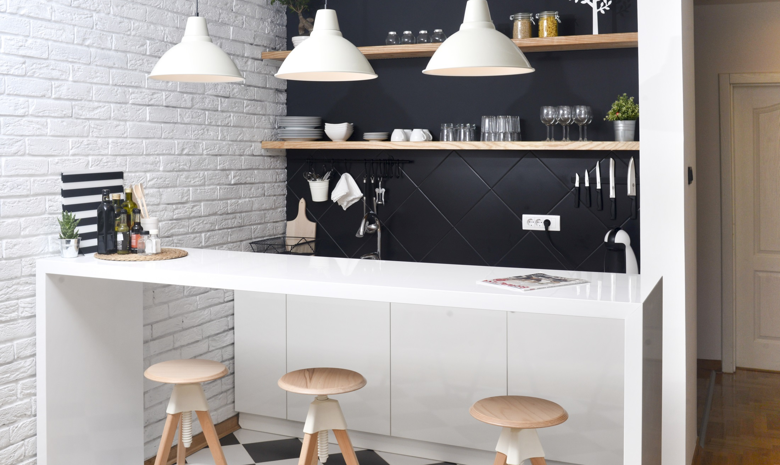

Slide 10
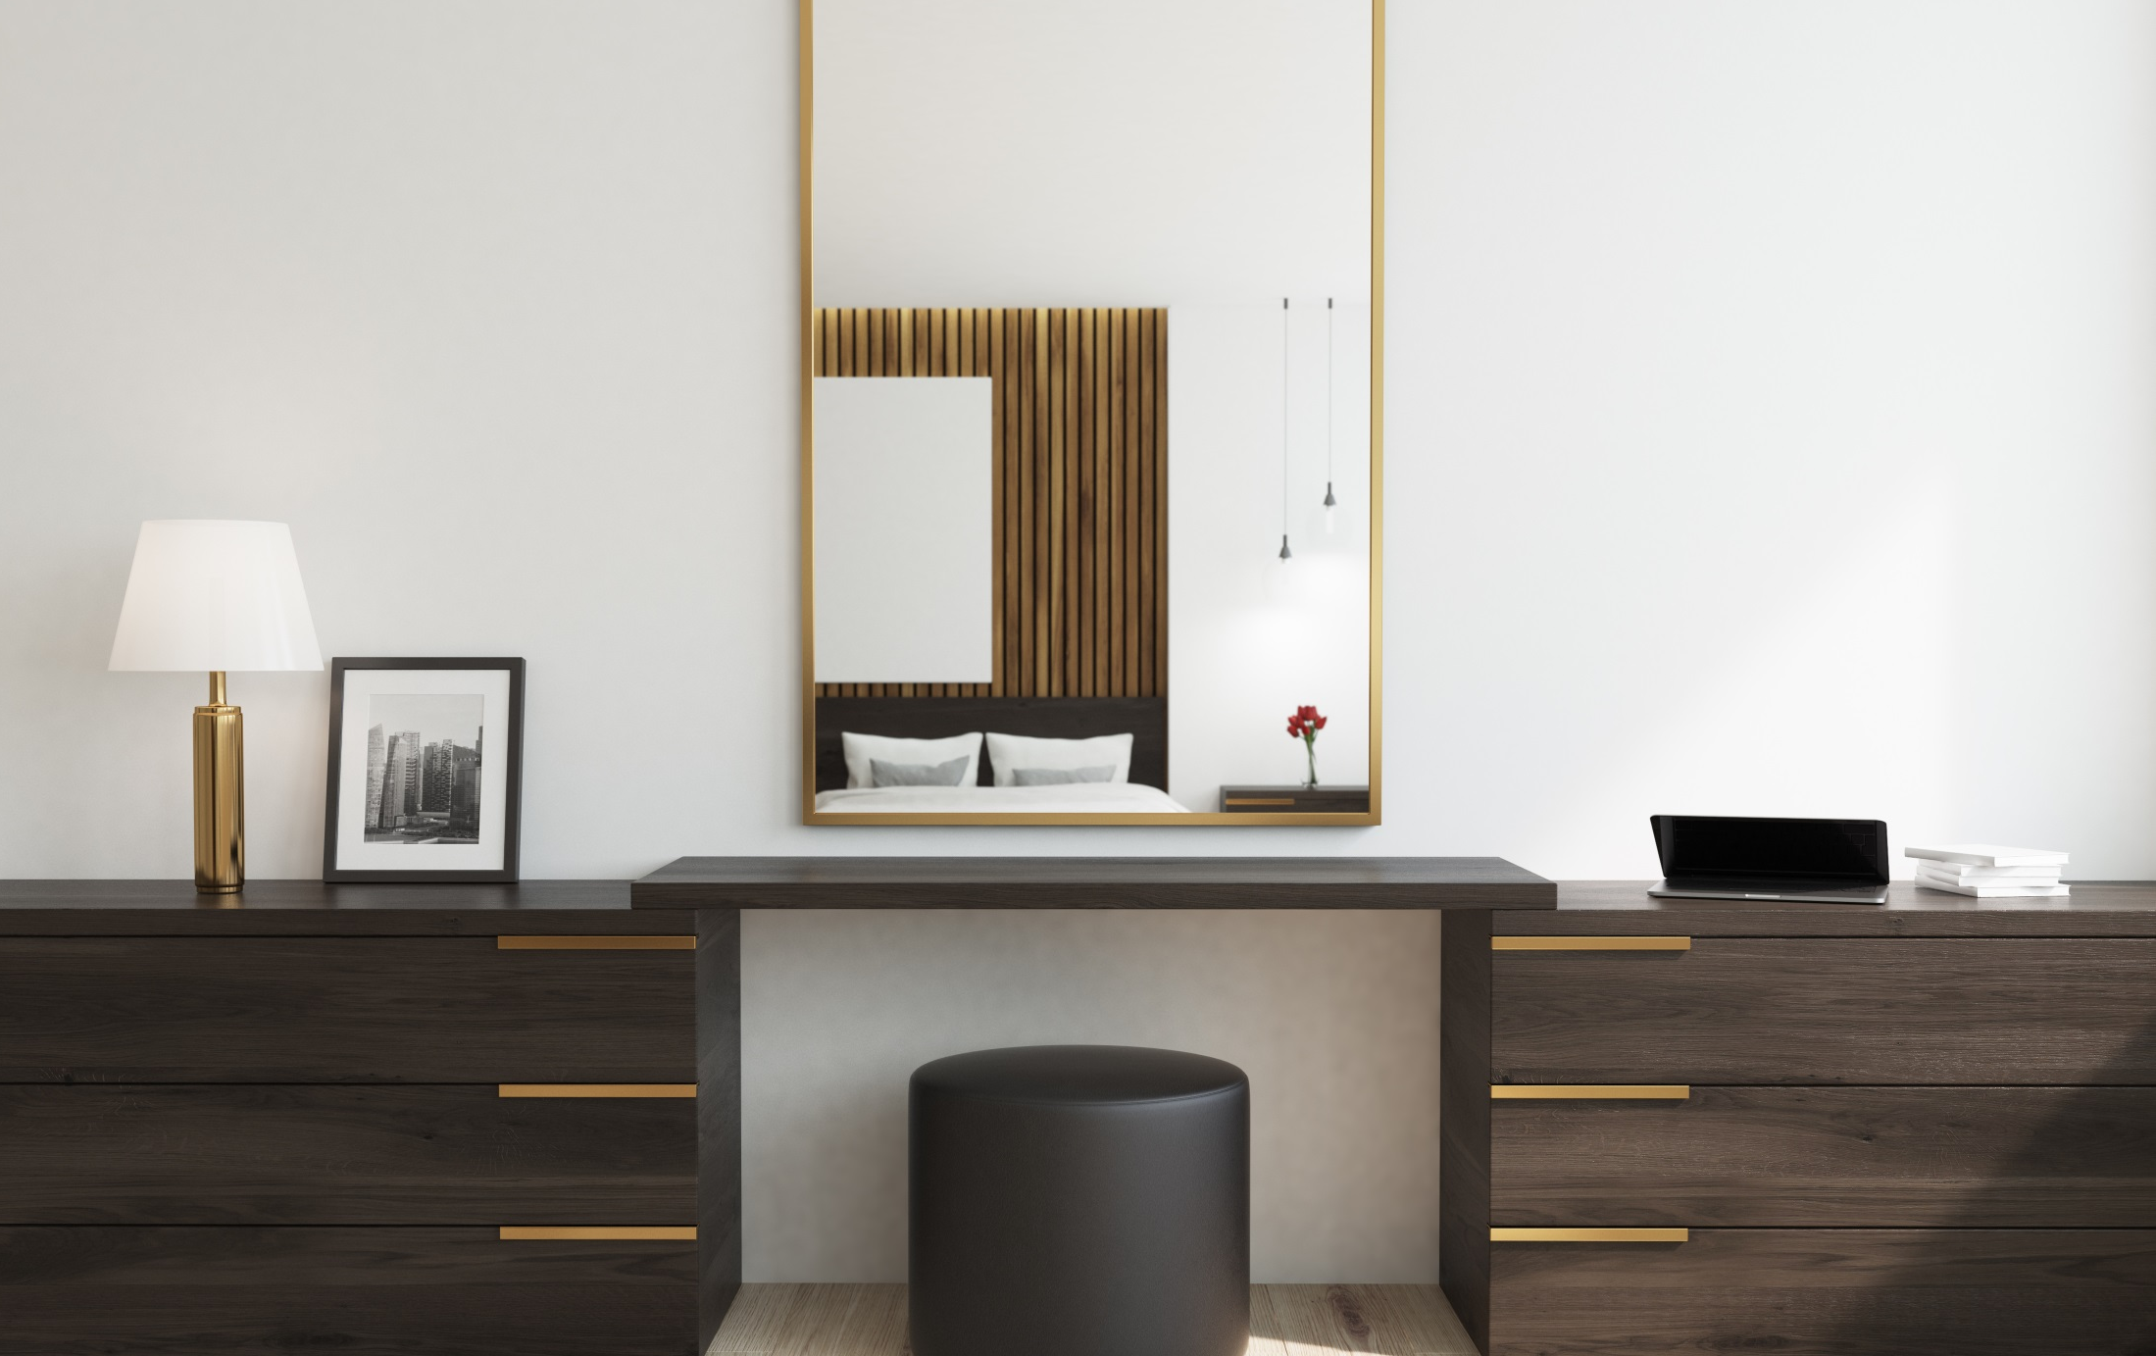

Slide 11
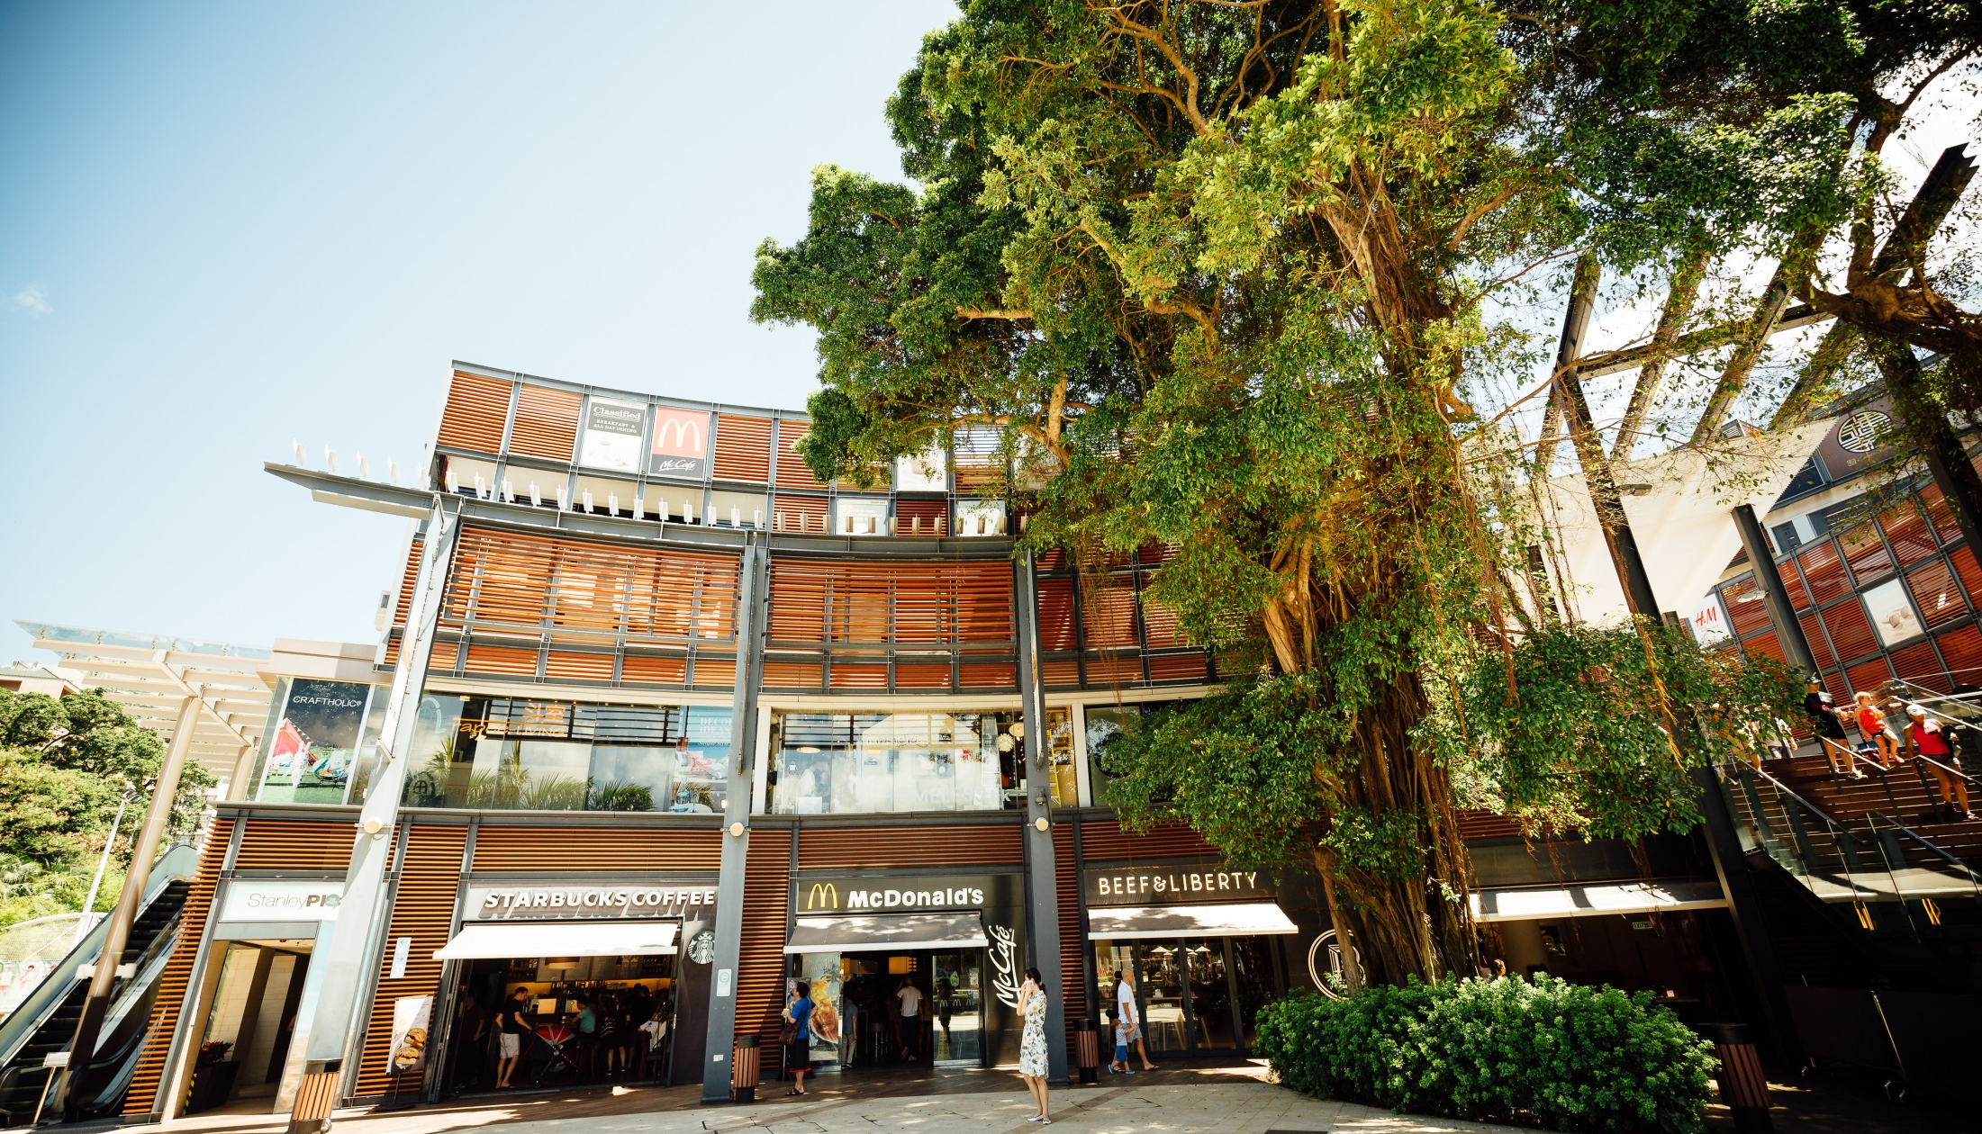

Slide 12
 | BV | 零售利潤
Isotonix OPC-3®沖飲 | 43.5 | 180.00
Isotonix® 美肌OPC-3®沖飲 | 43.5 | 178.00
Isotonix® 綜合維他命沖飲 | 28.5 | 121.00
Isotonix® 維他命C沖飲 | 16 | 84.00
Fixx™ 摩洛哥堅果油洗髮乳 | 11 | 52.00
Fixx™ 摩洛哥堅果油護髮素 | 11 | 52.00
Fixx™ 豐盈洗髮乳及護髮素（二合一） | 9.25 | 45.00
Fixx™ 摩洛哥堅果油髮膜 | 11 | 57.00
Fixx™ 微粒面部磨砂膏 | 14 | 63.00
Royal Spa™ 沐浴露 | 6.5 | 40.00
Lumière de Vie® 極緻妍亮尊貴組合 | 200 | 1006.00
Skintelligence® 深層潔膚乳液 | 7.25 | 52.00
Skintelligence® pH 平衡爽膚水 | 7.25 | 49.00
Skintelligence® 鎖水保濕乳液 | 11 | 66.00
Motives® 無瑕美肌透亮碎粉 | 12 | 60.00
Motives® 眼影 | 7.75 | 38.00
Motives® 無瑕美肌兩用粉餅 | 16.5 | 75.00
Motives® 透薄定妝高清粉餅 | 16 | 70.00
Motives® 潤澤雙色唇膏 | 12 | 52.00
Motives® 無瑕美肌妝前底霜 | 14 | 59.00
Motives® 礦物粉底液 | 15 | 75.00
Motives® 瞬間無瑕定妝噴霧 | 17 | 79.00
Motives® 專業化妝掃套裝 | 50 | 337.00
Royal Spa™ 造型啫喱 | 4.5 | 30.00
Royal Spa™ 夏威夷白姜造型泡沫 | 5 | 41.00
總零售利潤 | 589.5 | 2961.00
銷售產品的
零售利潤
Notes:


Slide 13

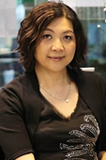
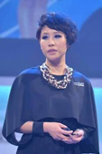
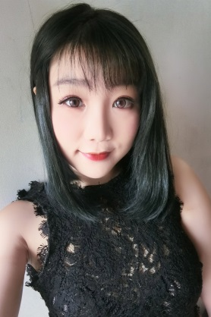
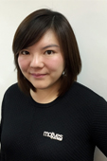
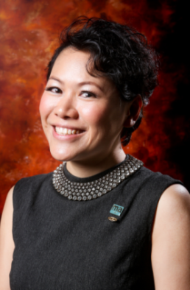


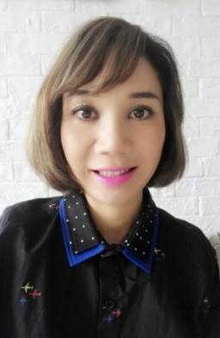
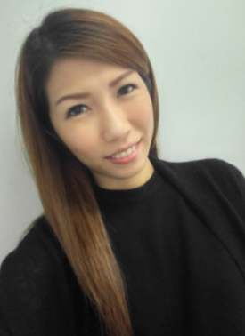
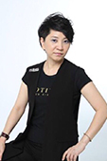
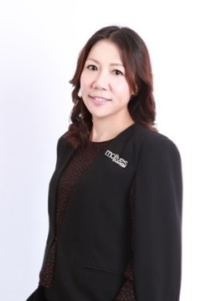


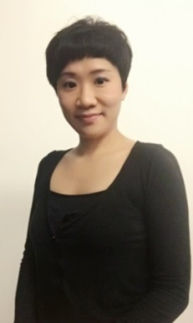
MOTIVES®授證訓練員
Rose Wong
Reginia Wong
Angie Chou
Blair Lo
Kero Chan
Thorine Mak
Mony Ung
Claudia Chow
Ming Chung
Meko Lun
Pat Chan
Queenie Lau
Andy Leung
Yan Liu
Mandy Ng
Notes:


